Slide 1

计算机组成原理自主实验
Multiple Interrupt
Notes:
Good Morning, guys!
I’m Bai Guangtong from the Night’s Watch.
Today I am gonna introduce a crash course called “Big History” to you.
Hope you can like it.

Slide 2

Multiple Interrupt
Division of Labor
黄渝光
杨志飞
郭宏子龙
构思、设计整体框图
设计程序流程
排队器
屏蔽字设定
中断响应模块
中断屏蔽模块
服务程序进度条
构思、设计整体框图
设计程序流程
时钟信号降频模块
屏蔽字设定与显示模块
堆栈和现场保护与恢复
7段数码管显示
程序代码整理与调试
对整体框图设计进行修改
对程序流程进行修改
对各模块和系统进行仿真调试
记录仿真波形
视频制作

Slide 3
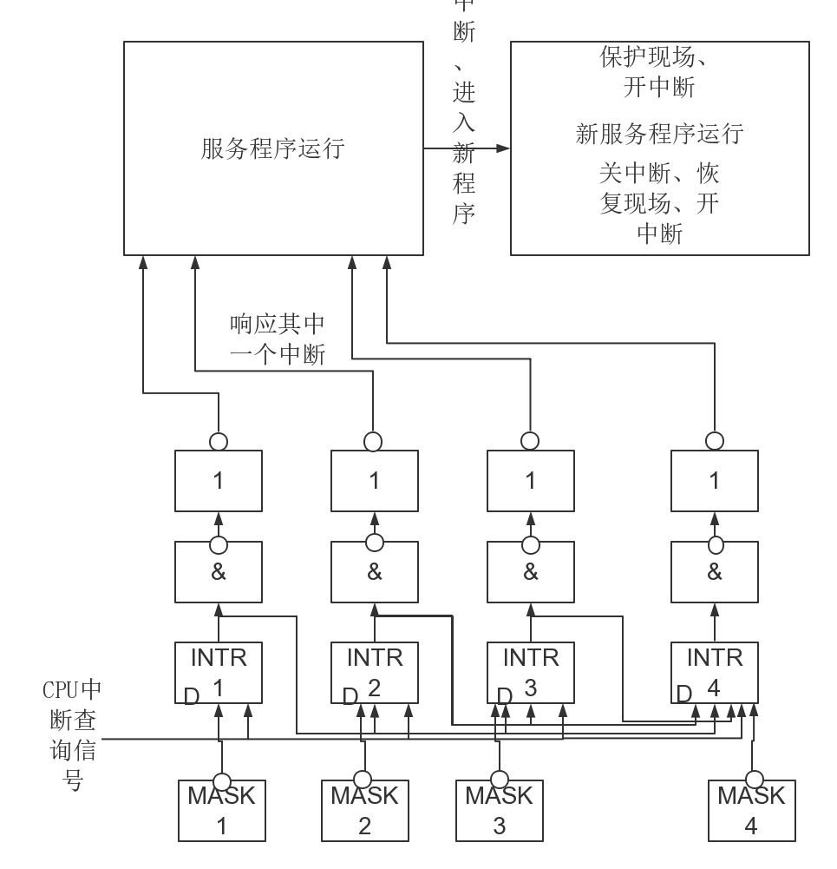
Multiple Interrupt
Overview
Notes:
As what the course says, in Big History, we're gonna start history when it really starts.
The course consists of 9 episodes in total. From “The Big Bang” to “The Anthropocene and the Near Future”.
However, the last 4 episodes have not been translated yet, so the subtitile is not available now.
If you are confident at your English listening level, you can try them sometimes.
But I recommend not, because I have tried them by myself already. It seems to me that there are a lot of proper nouns in them which can make them very confusing and puzzling.
So, in the following time, let’s put attention on the first 5 episodes.

Slide 4
Multiple Interrupt
Module
排队器
中断响应模块
中断屏蔽模块
服务程序进度条
时钟信号降频模块
屏蔽字设定与显示模块
堆栈和现场保护与恢复
7段数码管显示
Notes:
As what the course says, in Big History, we're gonna start history when it really starts.
The course consists of 9 episodes in total. From “The Big Bang” to “The Anthropocene and the Near Future”.
However, the last 4 episodes have not been translated yet, so the subtitile is not available now.
If you are confident at your English listening level, you can try them sometimes.
But I recommend not, because I have tried them by myself already. It seems to me that there are a lot of proper nouns in them which can make them very confusing and puzzling.
So, in the following time, let’s put attention on the first 5 episodes.

Slide 5
Multiple Interrupt
Function and Demonstration
用户设定屏蔽字
用户可根据需要自己设定每个服务程序的中断字。
中断请求与响应
中断请求与响应反应及时，既实现了服务程序撤销请求的版本也实现了请求保持的版本。
程序运行可视化
程序运行的4秒不同阶段显示于LED灯上，清楚显示中断流程。
Notes:
Finally, with regard to why we chose this course.
There are mainly 3 reasons.
The first one is that the course is joyful and fun due to the speaker’s humor and a lot of cartoons. We don’t want to introduce some open courses that we knew you wouldn’t even touch it after this class, like machine learning or introduction to algorithms.
Secondly, The course is useful. It tells the history from the true beginning and covers almost everything. Admittedly, we have more scientific knowledge than most people. But we are in a lack of culture, especially about history. So, let’s get on some historical stuff.
Last but not least, it’s quite short. Each episode lasts for about 15 mins. Which means that you can learn more than half of the course with the time you spent on only 1 episode Of Game of Thrones or Grey’s Anatomy. So, why not try it. It won’t waste you too much time.

Slide 6

THANKS
FOR LISTENING
Multiple Interrupt
Notes:
This is all about the Crash Course Big History.
Thank you all for listening!
We are the Night’s Watch.

